Slide 1
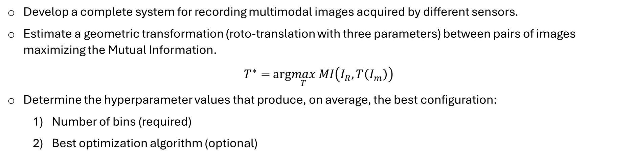
Assignment 1 – Computer Vision Multimodal Image Registration
Objectives
Develop a complete system for recording multimodal images acquired by different sensors. Estimate a geometric transformation (roto-translation with three parameters) between pairs of images maximizing the Mutual Information.
$T^{∗}=$ $arg\max_{T} MI\left(I_{R},T\left(I_{m}\right)\right)$
Determine the hyperparameter values that produce, on average, the best configuration:
Number of bins (required)
Best optimization algorithm (optional)
Dataset
The set of data is divided into validation and test sets, in each of which eight pairs of images from satellite acquisitions are available. In addition, the pairs in each set are characterized by progressive misalignment.
Gabriele Lo Cascio

Slide 2
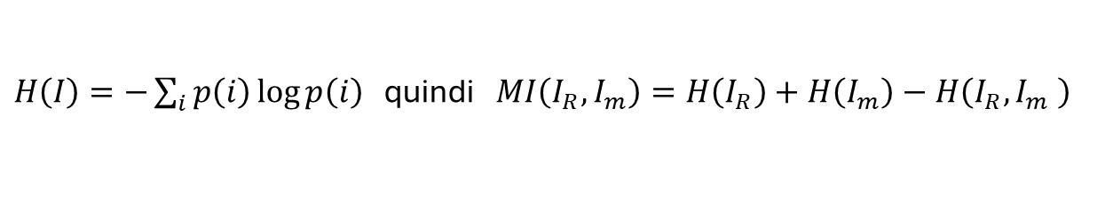
Introduction
Registration consists of determining a geometric transformation that aligns corresponding points of two images[1]. Given the different nature of the images to be analyzed, as they are acquired by different sensors, it is not possible to resort to feature-based methods. The idea is to establish a certain criterion of similarity between reference and moving images, i.e. the one transformed according to T. The criterion chosen is Mutual Information, which is based on the concept of entropy and is therefore directly linked to probability.
First, a 2D histogram is constructed, then the number of bins with which to divide the intensity range (0-255) is established, and we assume it is the same for both axes. Each bin represents a range of intensity. Then the pixels are analyzed in terms of indices of both images, and the pair (intensità_pixel_ref, intensità_pixel_mov) is obtained. The 2D histogram will then be a grid whose cells represent the absolute frequency, i.e. how many times this pair has occurred. Starting from the absolute frequencies, the relative frequencies are calculated, which in fact provide an estimate of the probability corresponding to the pair. Finally, the Mutual Information is calculated.
$H\left(I\right)=−\sum_{i}{p\left(i\right)\log{p\left(i\right)} }$ then $MI\left(I_{R},I_{m}\right)=H\left(I_{R}\right)+H\left(I_{m}\right)−H\left(I_{R},I_{m} \right)$

Slide 3
The procedure
The approach developed has a pipeline as its core. This pipeline receives the reference and moving pair as input, maximizes the MI and returns a vector of three components, each component representing a roto-translation parameter: tx, ty, theta. It should be noted that the maximization takes place thanks to an optimizer that uses different numerical methods.
The pipeline is very versatile as it allows you to set the number of bins with which to perform the MI calculation and the optimization method.
A hyperparameter gridsearch has been implemented involving that pipeline. In particular, the search domain requires that each hyperparameter takes one of the following values:
Number of bins -> (64, 128, 256)
Optimization method -> (Powell, Nelder-Mead, BFGS)
The gridsearch produces a csv file where all the configurations are present. Then an evaluation function extracts, as per the specifications, the one with the minimum average error.
It is important to note that the MAE metric was used to calculate the error.

Slide 4
First attempts
Early versions of the code performed a comprehensive gridsearch to find both the best optimization methods and the best number of bins. This is because not knowing anything a priori, we wanted to test the performance achieved in a rough way. The first problem was the presence of null probability values. Depending on the number of bins used, some cells have zero occurrences. This is because there are so many pairs of possible intensities. In this case, it was enough to apply a mask that considers only cells with positive values. The second problem was balancing the histogram. This is because, as a result of the T transformation, some pixels in the image are mapped outside the frame. For areas that remain "empty", OpenCV automatically assigns a zero intensity value. This causes a high increase in occurrences in which these black pixels are involved, thus making a greater contribution to these areas of absence of the image. In this case, we have considered a mask, having all white pixels, to which the T transformation is applied. So we consider only the positions of the white pixels following the transformation for the calculation of the histogram. This interpretation is the result of the work carried out by [2]. From the first results, the supremacy of the Powell method is evident, it was decided to proceed with its use because with the default configuration it produces results with satisfactory goodness.

Slide 5
T-Matrix and Preprocessing
Initially, the T transformation worked with the upper left point of the image as a rotation reference. This is because there was a direct correspondence with the GT, so that the error could be calculated and the results compared immediately. However, according to what was obtained in [3], significant improvements have been noted if the center of the image is taken as a reference. Different preprocessing strategies were used in order to bring out distinctive characteristics. The simplest were to convert to grayscale and take advantage of the Value channel of the HSV color space. A further technique was to apply PCA: in fact, each point of the image is initially a vector of three components (BGR), so the direction of maximum variance of these points can be obtained and the value of the projection along that direction can be associated as an intensity value to each point. These strategies were also used in combination with a subsequent Gaussian blurring, trying different kernels.

Slide 6
Scientific insights
Once the structure of the code and the method of evaluation of the pipeline were defined, it was decided to search the literature for contributions that could provide both ideas and methodologies. The mere use of the Powell method has prompted the approach in an attempt to use the other proposed optimization methods as well. Several attempts have been made with BFGS, however no great results have been achieved in accordance with what has been obtained in [4]. The Nelder–Mead method was implemented as suggested by [4] and, without going into too much detail, the same simplex configuration was employed. Note that the paper specifies the simplex parameters related to translations with units of measurement in millimeters. However, although the units of measurement do not match those adopted (pixels), applying these initializations still results are rather satisfactory. So with Nelder-Mead better performances were achieved than with Powell. It has also been discovered that it is possible to set the Nelder–Mead method with an adaptive variant as reported in [5], just add a flag. However, it was not advantageous to do so. According to [4], the vector of the parameters of the transformation T (tx, ty, theta), can be initialized as (0, 0, 5°). However, better performance was achieved with initialization (0, 0, 0).

Slide 7
Results obtained on the val set
The unit of measurement is pixels for tx and ty, while radians for theta.
Ordered configurations with priority over translation error, calculated by combining x-axis and ordinate.
preprocessing | metodo | numero bin | mae_tx | std_tx | mae_ty | std_ty | mae_theta | std_theta
hsv_v-gauss-3 | Nelder-Mead | 64 | 3.05 | 2.87 | 3.67 | 3.35 | 0.0009 | 0.0009
gray | Nelder-Mead | 64 | 3.07 | 2.90 | 3.71 | 3.34 | 0.0008 | 0.0005
gray-gauss-3 | Nelder-Mead | 64 | 3.01 | 2.91 | 3.76 | 3.40 | 0.0010 | 0.0008
hsv_v-gauss-7 | Nelder-Mead | 128 | 3.01 | 2.86 | 3.70 | 3.38 | 0.001 | 0.001
gray-gauss-5 | Nelder-Mead | 128 | 3.04 | 2.87 | 3.71 | 3.34 | 0.0009 | 0.0008
pca-gauss-5 | Nelder-Mead | 64 | 3.03 | 2.88 | 3.71 | 3.43 | 0.0007 | 0.0006
better configuration, as it is the only one present in the best tops of both groups
Configurazioni ordinate con priorità rispetto all’errore di rotazione.
preprocessing | metodo | numero bin | mae_tx | std_tx | mae_ty | std_ty | mae_theta | std_theta
gray | Nelder-Mead | 128 | 3.11 | 2.94 | 3.73 | 3.43 | 0.0005 | 0.0004
pca-gauss-5 | Nelder-Mead | 64 | 3.03 | 2.88 | 3.71 | 3.43 | 0.0007 | 0.0006
gray-gauss-5 | Nelder-Mead | 64 | 3.07 | 2.94 | 3.74 | 3.42 | 0.0007 | 0.0005
hsv_v | Nelder-Mead | 128 | 3.06 | 2.93 | 3.77 | 3.33 | 0.0007 | 0.0007
gray | Nelder-Mead | 256 | 3.06 | 2.94 | 3.77 | 3.34 | 0.0007 | 0.0008
pca | Nelder-Mead | 256 | 3.07 | 2.91 | 3.80 | 3.34 | 0.0007 | 0.0005

Slide 8
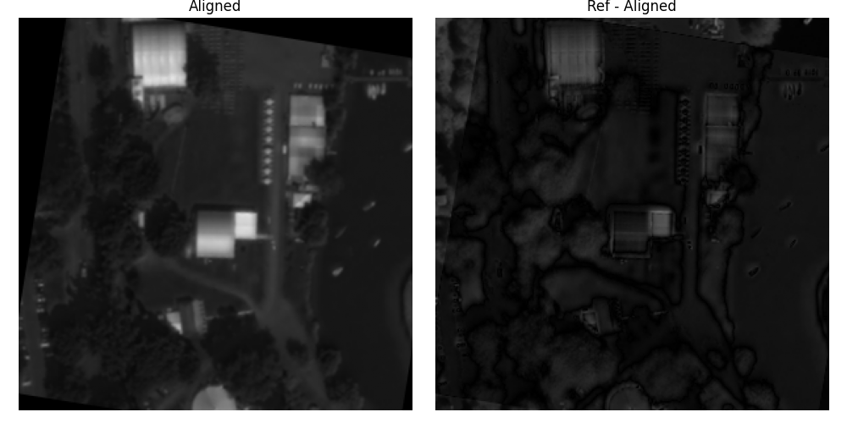

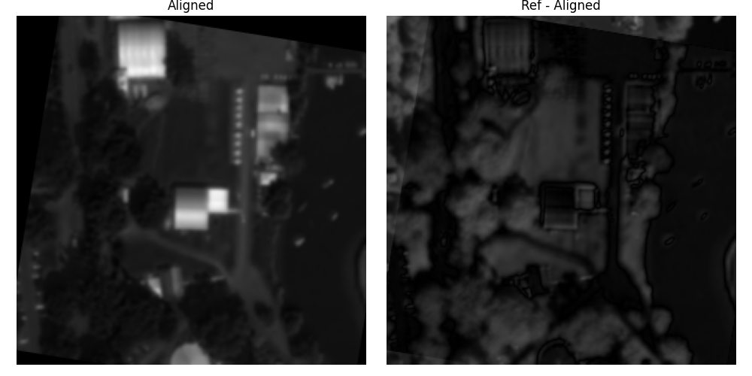
Some qualitative results on the val set
Pair: c3, Preprocessing: hsv_v, Method: Powell, Bins: 256
Pair: c3, Preprocessing: gray-gauss-5, Method: Nelder-Mead, Bins: 128
Pair: c3, Preprocessing: pca-gauss-5, Method: Nelder-Mead, Bins: 64

Slide 9
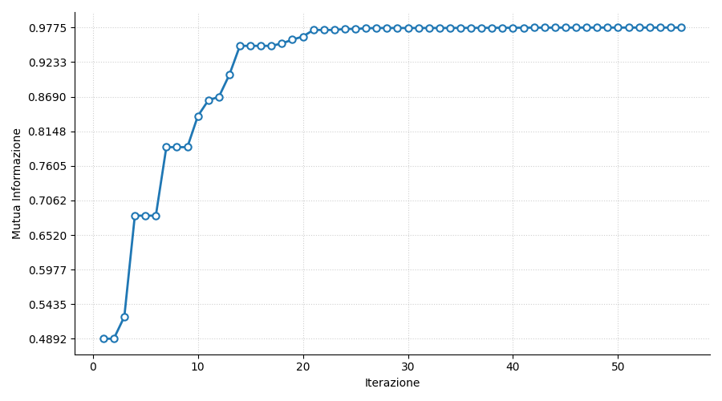
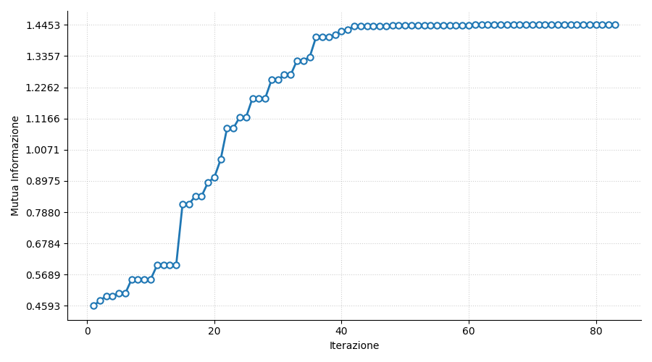
MI trend
Trend of the E for the c3 pair of the val set, Preprocessing: pca-gauss-5, Method: Nelder-Mead, Bins: 64
Trend of the E for the c6 pair of the val set, Preprocessing: pca-gauss-5, Method: Nelder-Mead, Bins: 64

Slide 10
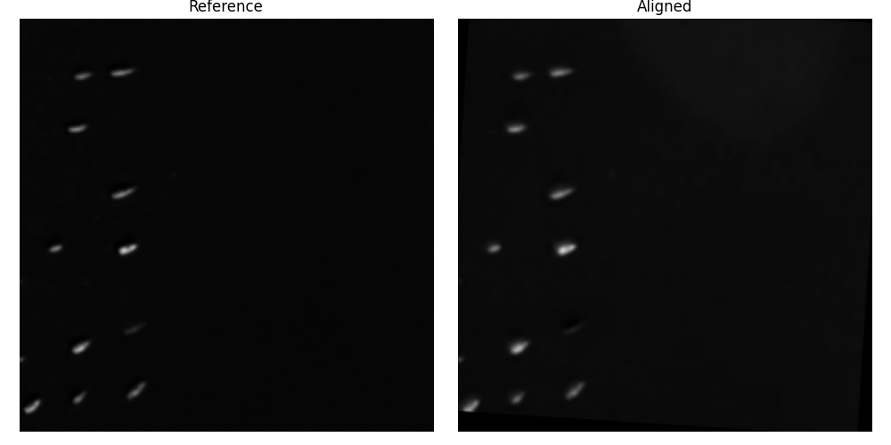
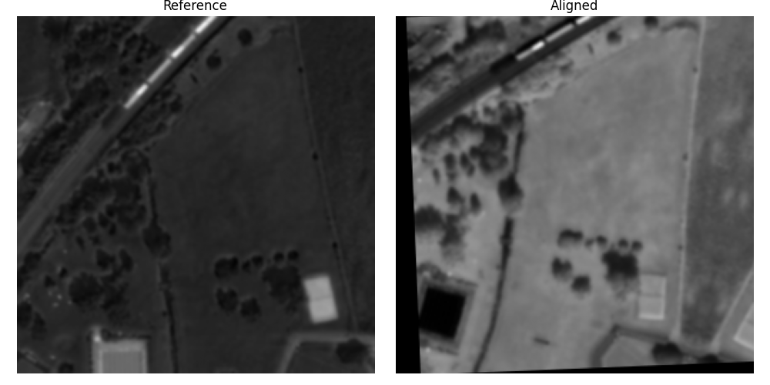
Performance on the test set
The unit of measurement is pixels for tx and ty, while radians for theta.
immagine | coppia | tx | residuo | ty | residuo | theta | residuo
zh3_01_03 | c1 | 8.97 | 0.90 | -15.01 | 0.02 | 0.0645 | 0.0004
zh3_02_01 | c2 | 16.55 | -1.15 | -5.16 | 0.21 | 0.0788 | -0.0007
zh3_03_01 | c3 | -23.82 | 0.96 | 23.71 | 1.62 | -0.0915 | -0.0012
zh3_03_02 | c4 | -27.13 | 0.51 | 27.29 | 1.14 | -0.1017 | -0.0017
zh1_01_03 | c5 | -14.80 | 37.89 | 23.06 | -34.57 | -0.1426 | 0.1084
zh1_01_04 | c6 | -20.99 | -4.90 | 19.40 | -3.46 | -0.2450 | -0.0008
zh1_01_03 | c7 | -3.70 | 17.17 | 8.21 | -25.23 | -0.0154 | 0.3330
zh1_02_01 | c8 | 8.80 | 22.80 | 1.46 | -77.23 | -0.0405 | 0.2782
Best result: pair c1
Average results
mae_tx | std_tx | mae_ty | std_ty | mae_theta | std_theta
10.80 | 13.86 | 17.93 | 27.36 | 0.0905 | 0.1386
Worst result: c8 pair

Slide 11
Bibliography
[1] CHAPTER 8-Image Registration, J. Michael Fitzpatrick, Derek L. G. Hill, Calvin R. Maurer, Jr.
[2] Voxel Similarity Measures for 3D Serial MR Brain
[3] Robust Image Registration Based on Mutual Information
[4] Comparative evaluation of multiresolution optimization strategies for multimodality image registration by maximization of mutual Information, Frederik Maes
[5] Implementing the Nelder-Mead simplex algorithm with adaptive parameters, Fuchang Gao, Lixing Han
Disclaimer
Generative models such as Gemini and Claude have been used to:
Realization of the parts of code involving the matplotlib library
Quickly interact with library documentation
The Perplexity search engine has been used to find and analyze scientific papers, it has been useful above all to understand how to materialize some scientific ideas in Python code.

Slide 12
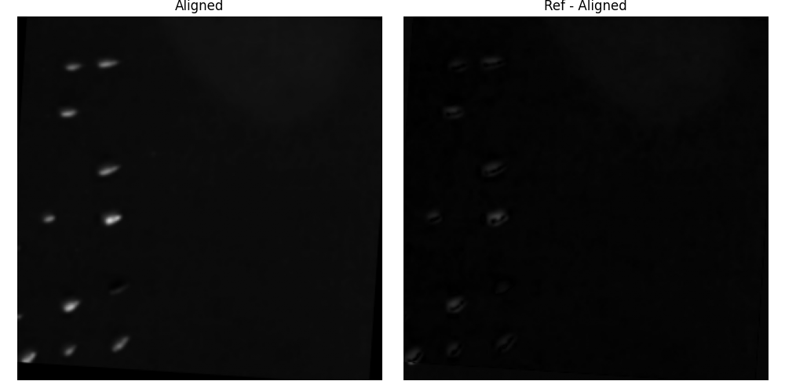
Coppia: c1, Preprocessing: pca-gauss-5, Metodo: Nelder-Mead, Bins: 64

Slide 13
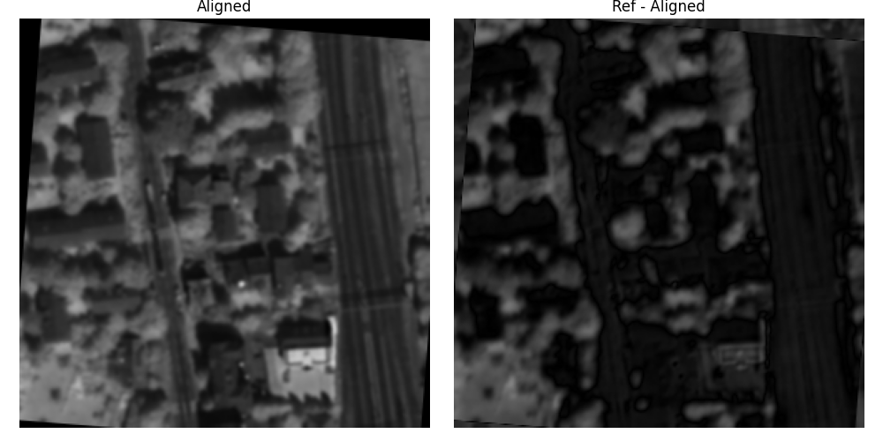
Coppia: c2, Preprocessing: pca-gauss-5, Metodo: Nelder-Mead, Bins: 64

Slide 14
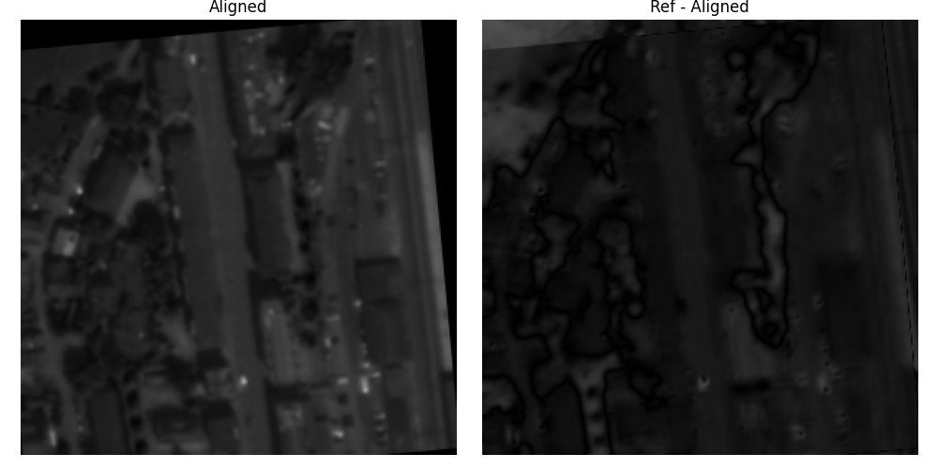
Coppia: c3, Preprocessing: pca-gauss-5, Metodo: Nelder-Mead, Bins: 64

Slide 15
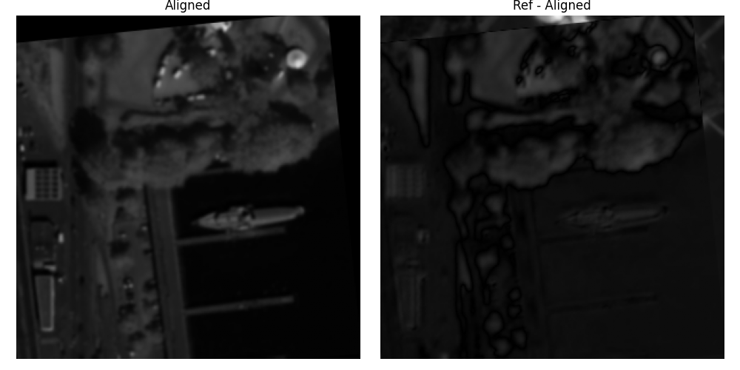
Coppia: c4, Preprocessing: pca-gauss-5, Metodo: Nelder-Mead, Bins: 64

Slide 16
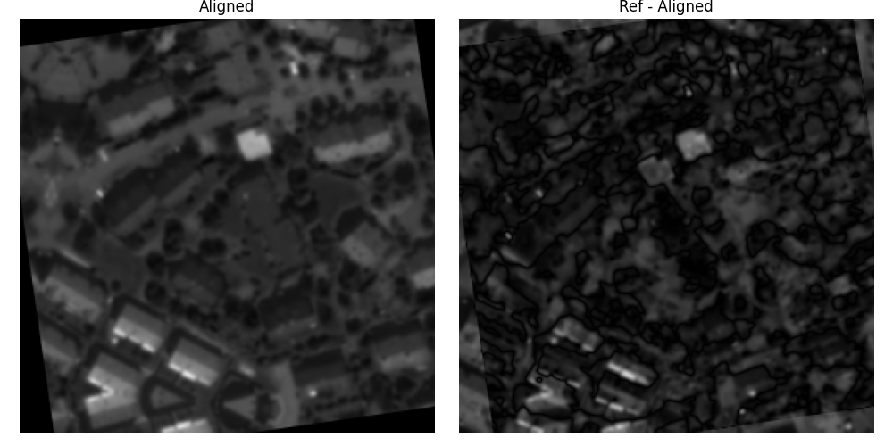
Coppia: c5, Preprocessing: pca-gauss-5, Metodo: Nelder-Mead, Bins: 64

Slide 17
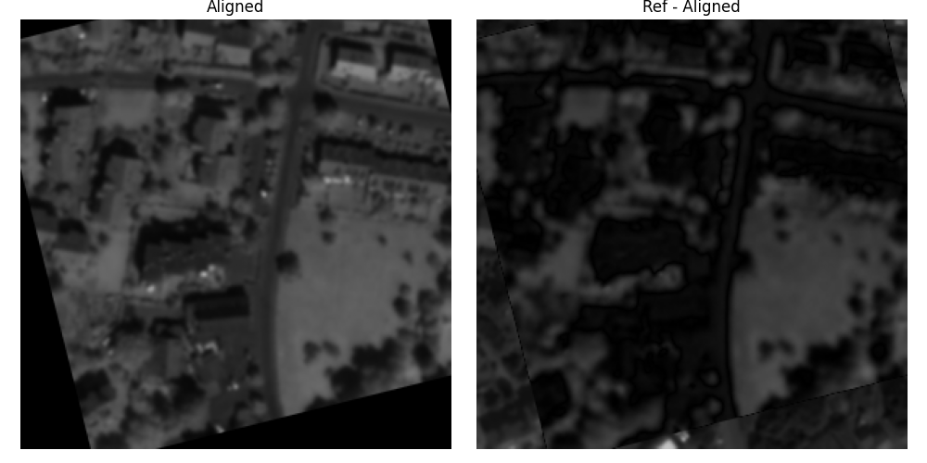
Coppia: c6, Preprocessing: pca-gauss-5, Metodo: Nelder-Mead, Bins: 64

Slide 18
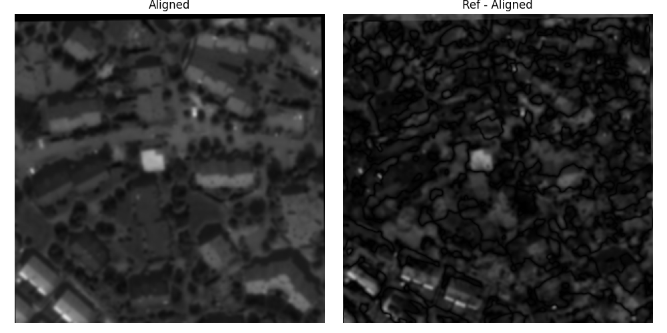
Coppia: c7, Preprocessing: pca-gauss-5, Metodo: Nelder-Mead, Bins: 64

Slide 19
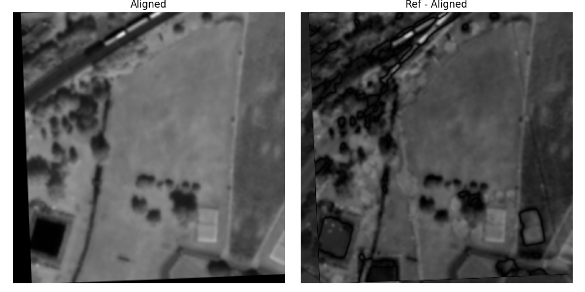
Coppia: c8, Preprocessing: pca-gauss-5, Metodo: Nelder-Mead, Bins: 64

